Slide 1
GEO+TCGA
JIMMY

Slide 2
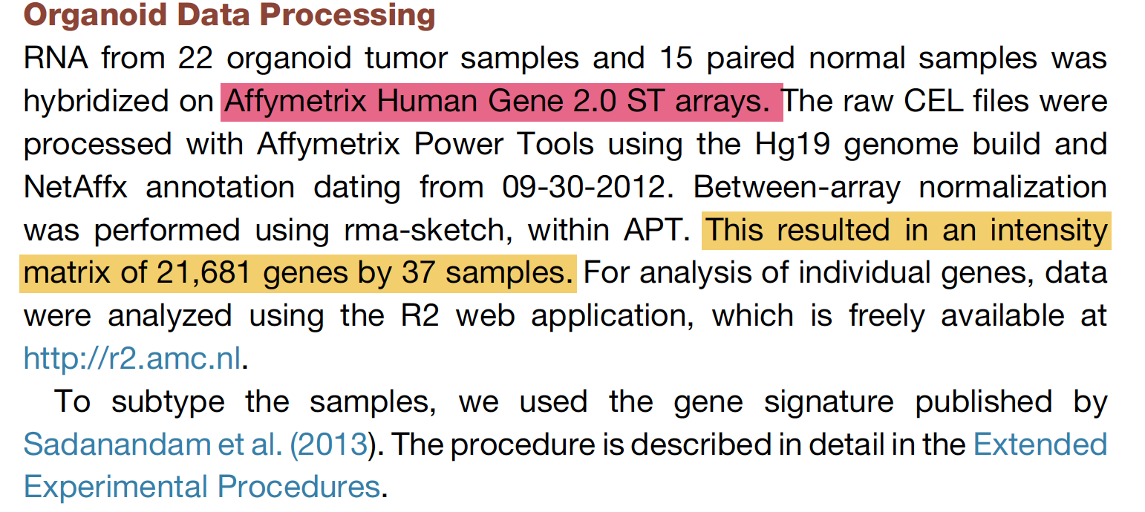

Slide 3
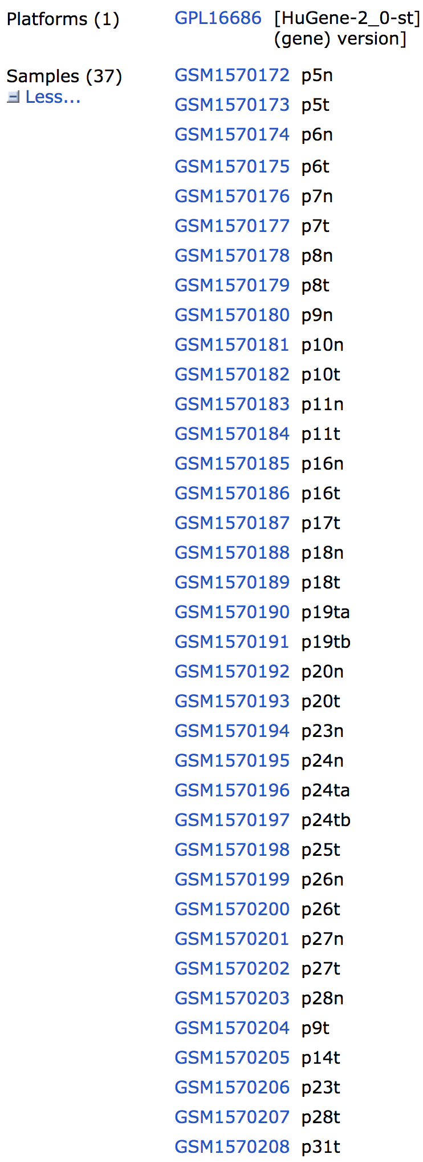
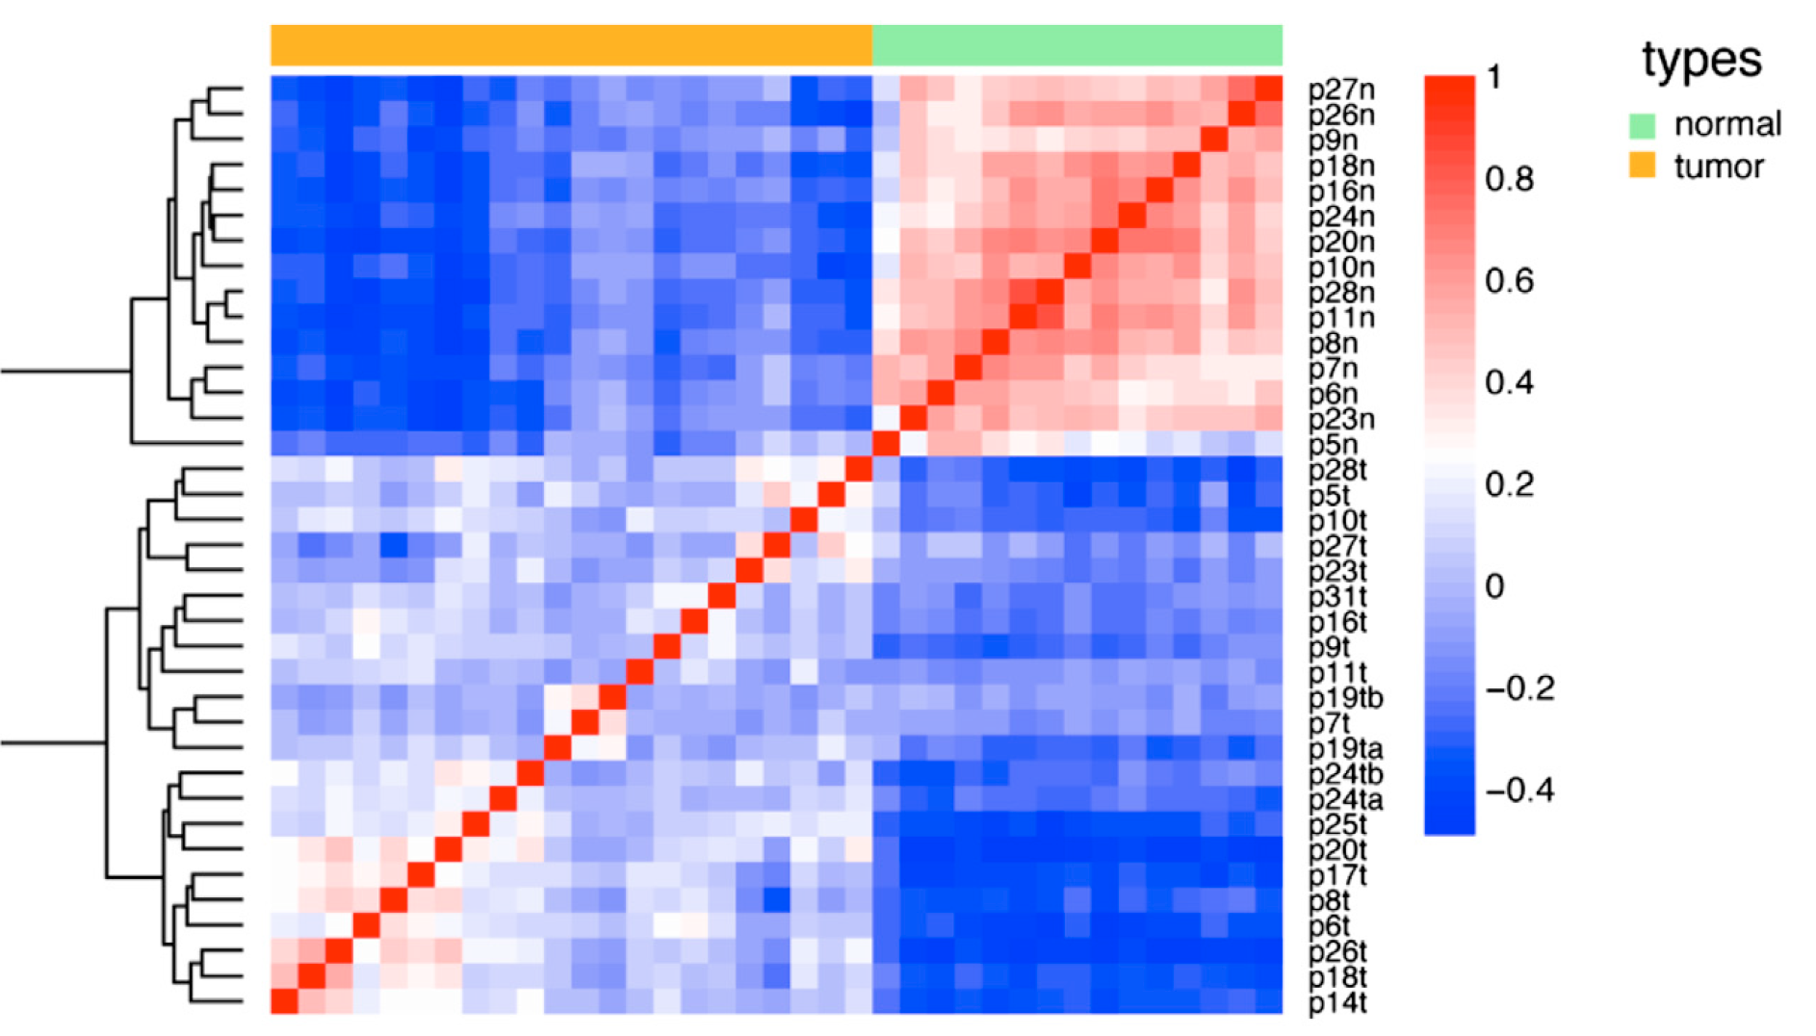
https://www.ncbi.nlm.nih.gov/geo/query/acc.cgi?acc=GSE64392

Slide 4
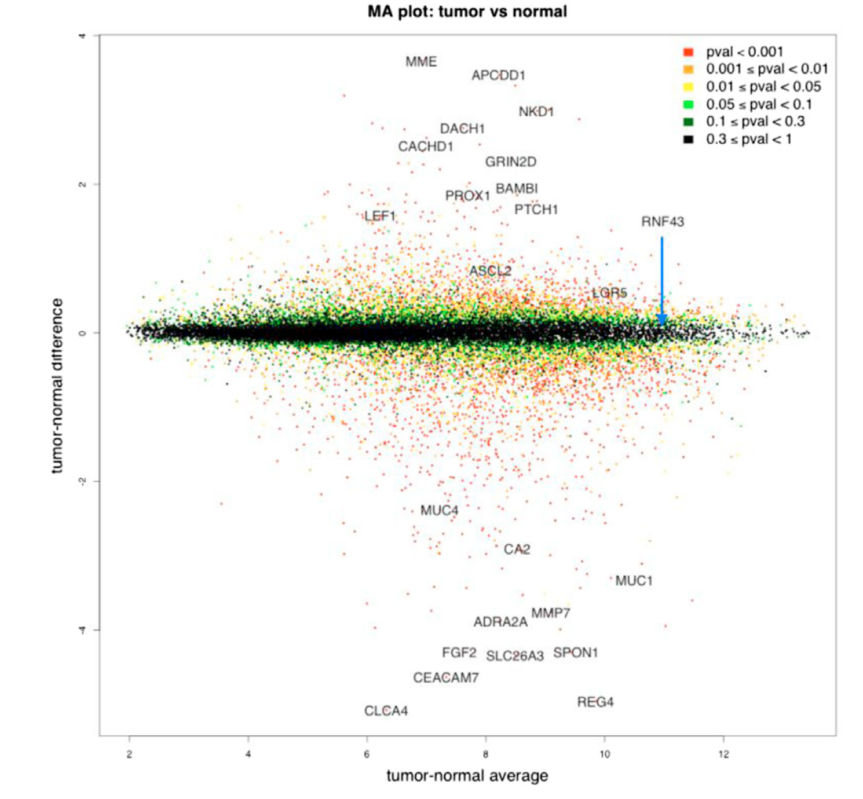

Slide 5
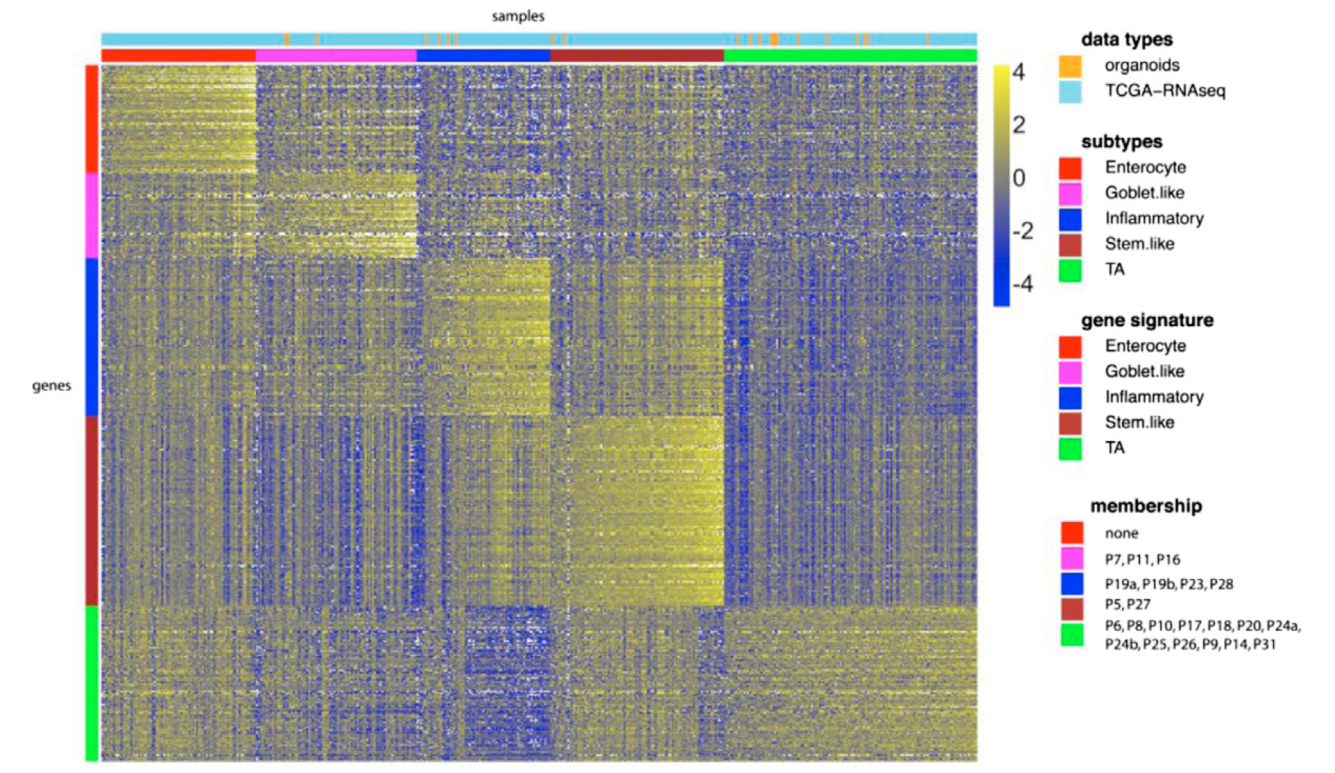
Notes:
CRC molecular subtypes are represented
by the organoid panel. Genes by samples heat
map of normalized gene expression of 22 organoid
samples and 431 TCGA RNA-seq tumor tissue
samples, organized by subtype.

